Slide 1
EMG analysis

Slide 2
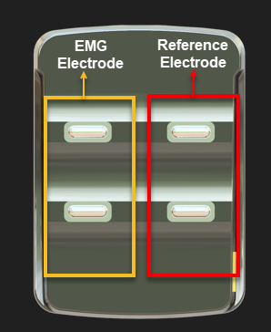

Slide 3
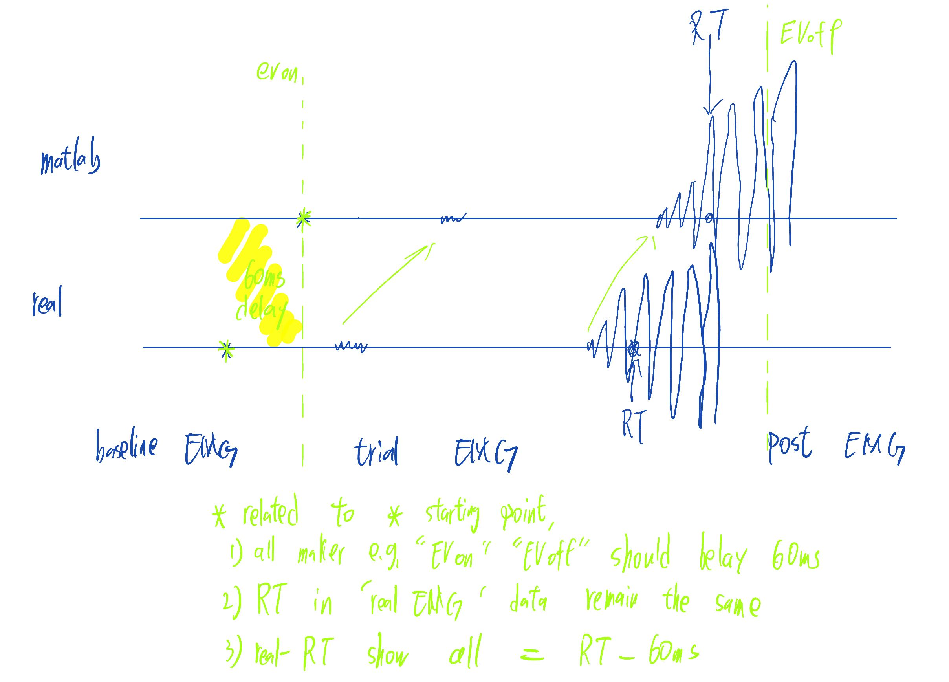
Delay elimination

Slide 4











Slide 5
MT=RT- EMG onsite
p-value: 1.8912e-100
Confidence Interval: 0.036577 to 0.04378
BCP Motor time 36ms-43ms faster than FDI
Diff. shape means different DM strategy?
FDI 100ms faster; BCP 60ms faster (use for RL update)
Summary Statistics for Data1:
Mean: 0.103
Median: 0.093221
Standard Deviation: 0.065253
Min: 0.00012133
Max: 0.39156
Interquartile Range (IQR): 0.074934
Summary Statistics for Data2:
Mean: 0.062822
Median: 0.057436
Standard Deviation: 0.044239
Min: 4.1341e-05
Max: 0.35746
Interquartile Range (IQR): 0.059474

Slide 6
Rt - EMG onsite time diff.
p-value: 2.442e-22
Confidence Interval: 0.017108 to 0.025685
BCP Motor time 17ms-25ms faster than FDI
Diff. shape means different DM strategy?
FDI 100ms faster; BCP 80ms faster (use for RL update)
Summary Statistics for Data1:
Mean: 0.10088
Median: 0.088457
Standard Deviation: 0.070309
Min: 0.00029868
Max: 0.39395
Interquartile Range (IQR): 0.083657
Summary Statistics for Data2:
Mean: 0.079486
Median: 0.066736
Standard Deviation: 0.063973
Min: 3.0422e-05
Max: 0.39125
Interquartile Range (IQR): 0.072819

Slide 7
EMG onsite FDI still faster!
MT has difference
Pre MT also has difference
FDI’s Per-MT is 60ms-10ms faster than BCP
p-value: 9.7893e-05
Confidence Interval: -0.060306 to -0.01995
Summary Statistics for Data1:
Mean: 0.87079
Median: 0.79414
Standard Deviation: 0.38769
Min: 0.0027547
Max: 1.9785
Interquartile Range (IQR): 0.51105
Summary Statistics for Data2:
Mean: 0.91092
Median: 0.84486
Standard Deviation: 0.37584
Min: 0.0027623
Max: 1.9819
Interquartile Range (IQR): 0.50655

Slide 8
EMG onsite (cdf)
The previous difference in RT was due to the same threshold and different MT in different muscles
p-value: 0.73196
Confidence Interval: -0.016667 to 0.023724
Summary Statistics for Data1:
Mean: 0.8951
Median: 0.82775
Standard Deviation: 0.37954
Min: 0.0027579
Max: 1.9819
Interquartile Range (IQR): 0.5083
Summary Statistics for Data2:
Mean: 0.89157
Median: 0.82572
Standard Deviation: 0.38458
Min: 0.0027557
Max: 1.9819
Interquartile Range (IQR): 0.50987

Slide 9


When response left, count burst right (most should =0) BCP is noisy, only see FDI
When response right, count burst right (most should =1) BCP is noisy, only see FDI
When response right, count burst left(most should =0)
When response left, count burst left (most should =1)

Slide 10


When response left, count burst right (most should =0) BCP is noisy, only see FDI
When response right, count burst right (most should =1) BCP is noisy, only see FDI
When response left, count burst right (most should =0)
When response left, count burst left (most should =1)

Slide 11
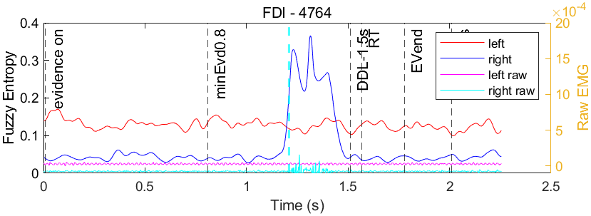
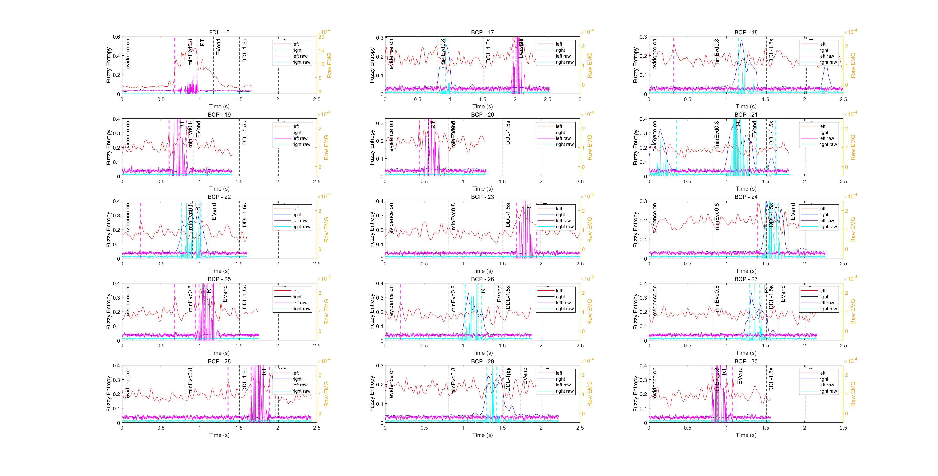
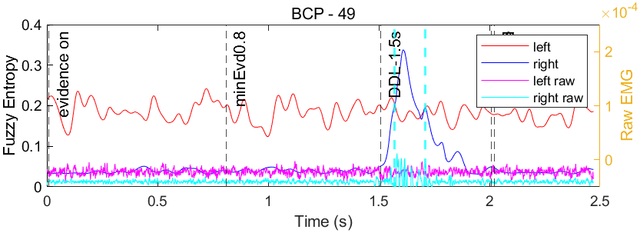
Very sensitive to noise

Slide 14



Slide 22
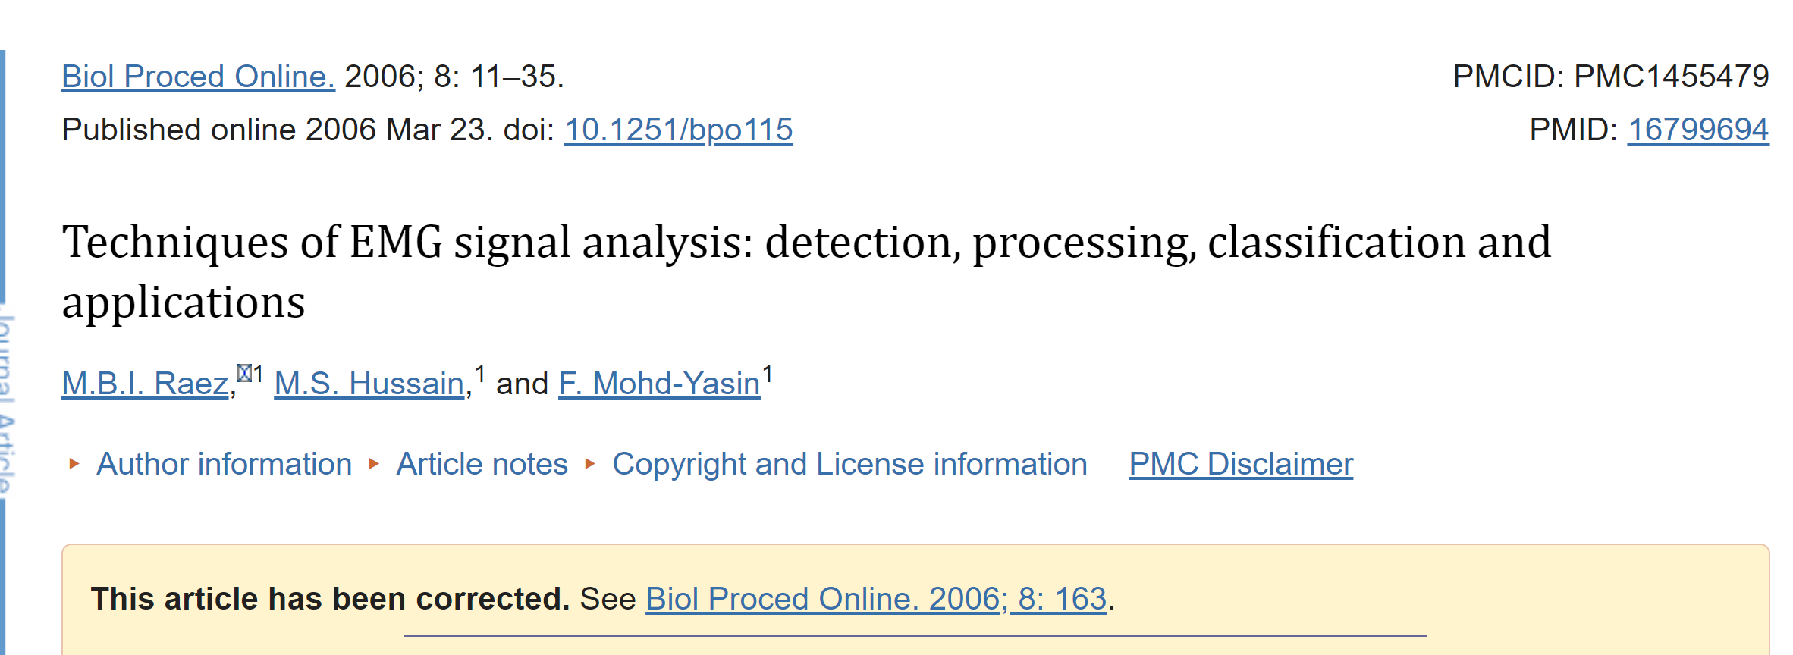
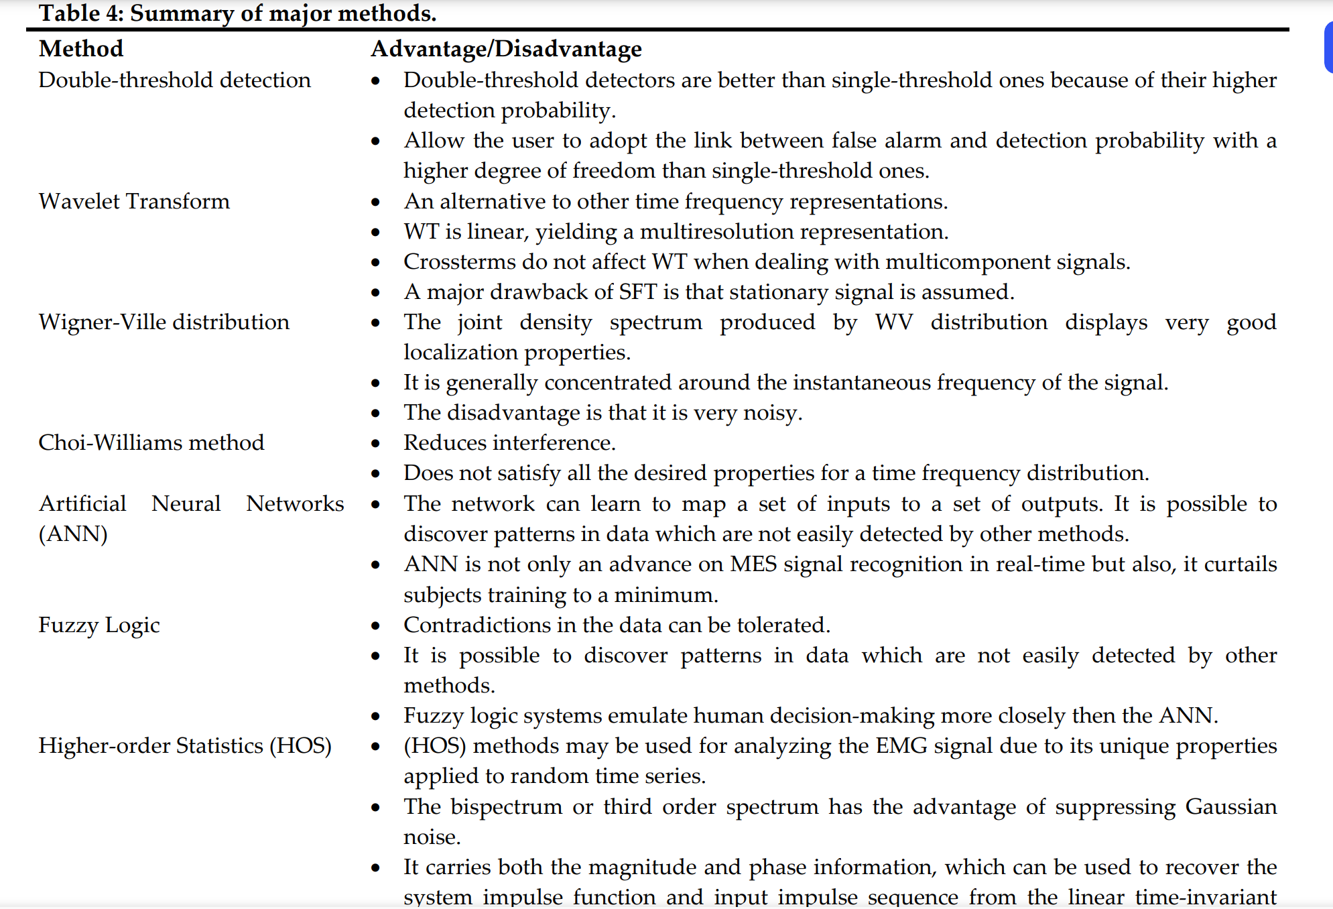



Slide 23
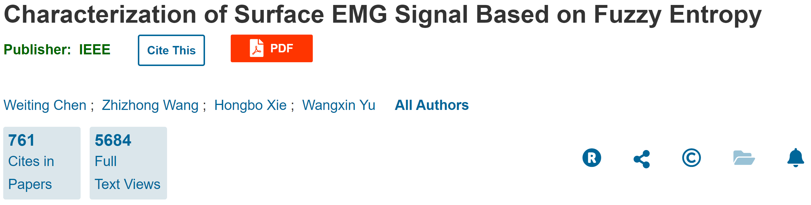
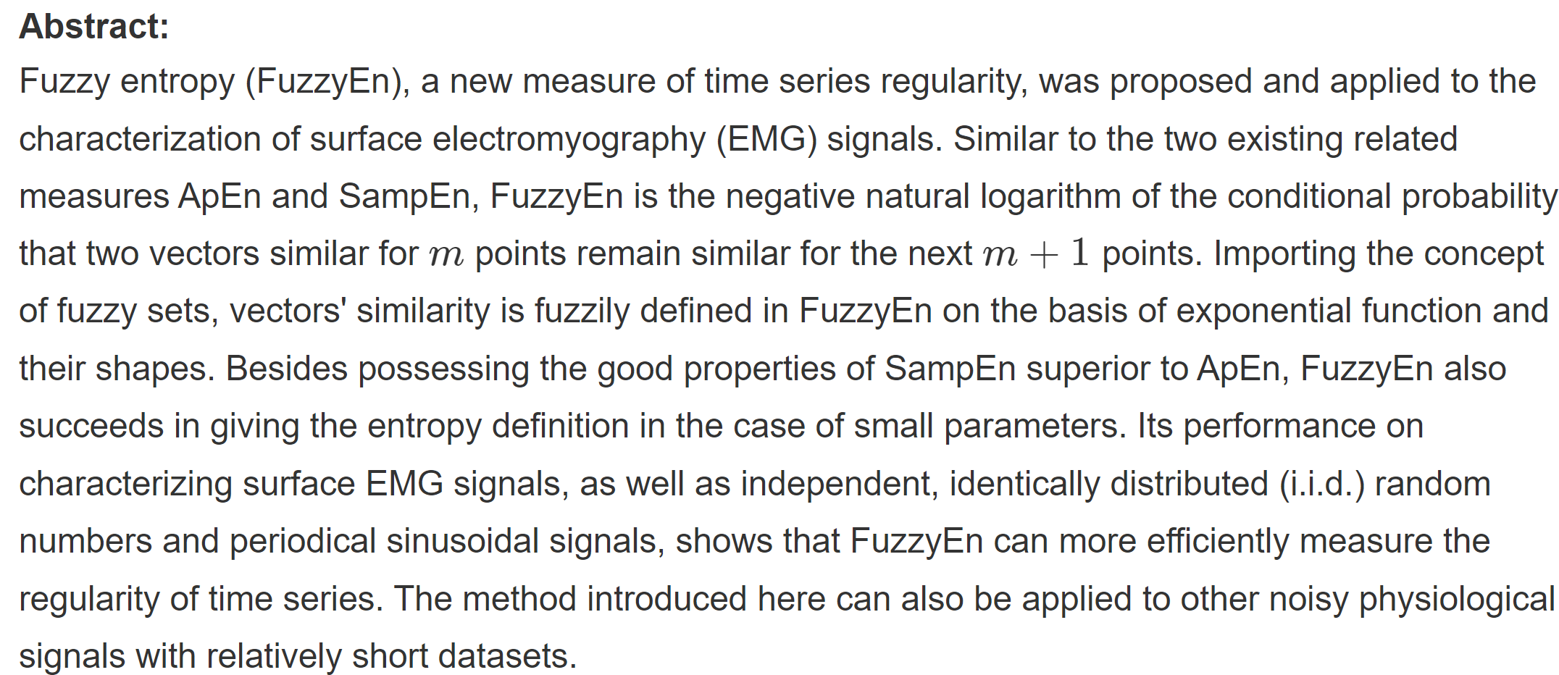


Slide 24



